Slide 1
Web Basics-JavaScript
Lesson 5: Document Object Model

Slide 2

Lesson Objectives
After completing this module you will be able to:
Understand the JavaScript Object Model
Understand the Window object, Frame and Navigator Object
Working with Location and History Object

Slide 3
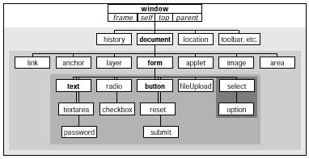
5.1: JavaScript Document Object Model JavaScript Document Object Model
Notes:
The figure shows the complete JavaScript document object hierarchy as implemented in Netscape Navigator 4. Notice that the window object is the topmost object in the entire scheme. Everything you script in JavaScript is in the browser’s window, be it the window itself or a form element. Of all the objects shown in the figure, you are likely to work most with the ones that appear in boldface. Objects whose names appear in italics are synonyms for the window object, and are used only in some circumstances. Pay attention to the shading of the concentric rectangles. Every object in the same shaded area is at the same level relative to the window object. When a link from an object extends to the next darker shaded rectangle, that object contains all the objects in darker areas. There exists at most one of these links between levels. A window object contains a document object; a document object contains a form object; a form object contains many different kinds of form elements. Study this figure to establish a mental model for the scriptable elements of a Web page. After you script these objects a few times, the object hierarchy will become second nature to you — even if you do not remember every detail ( property, method, and event handler) of every object. At least you know where to look for information.

Slide 4

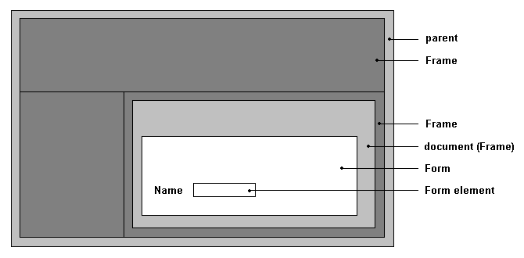
5.1: JavaScript Document Object Model JavaScript Document Object Model
Notes:
Creating JavaScript Objects
Most of the objects that a browser creates for you are established when an HTML document loads into the browser. The same kind of HTML code you used to create links, anchors, and input elements tell a JavaScript-enhanced browser to create those objects in memory. The objects are there whether or not your scripts call them into action.
The only visible differences to the HTML code for defining those objects are one or more optional attributes specifically dedicated to JavaScript. By and large, these attributes specify the event you want the user interface element to react to and what JavaScript should do when the user takes that action. If you rely on the document’s HTML code to perform the object generation, you spend more time figuring out how to do things with those objects or have them do things for you. Bear in mind that objects are created in their load order, which is why you should put most, if not all, deferred function definitions in the document’s Head. If you create a multi-frame environment, a script in one frame cannot communicate with another frame’s objects until both frames load.

Slide 5
5.1: JavaScript Document Object Model Object Properties
Define a particular, current setting of an object
Property names are case-sensitive
Each property determines it’s own read-write status
Any property you set survives as long as the document remains loaded in the window
For example:
document.forms[0].phone.value = “555-1212”
document.forms[0].phone.delimiter = “-”
Notes:
Object Properties
A property generally defines a particular, current setting of an object. The setting may reflect a visible attribute, such as a document’s background color. It may also contain information that is not so obvious, such as the form action and method when it is submitted.
Document objects have most of their properties assigned by attribute settings of HTML tags that generate the objects. Thus, a property may be a string (for example, a name) or a number (for example, a size). A property can also be an array, such as an array of images contained by a document. If the HTML does not include all attributes, the browser usually provides default value for both attributes and corresponding JavaScript properties.
When used in script statements, property names are case-sensitive. Therefore, if you see a property name listed as bgColor, you must use it in a script statement with that exact case usage. But when you set an initial value of a property by way of an HTML attribute, the attribute name ( like all of HTML) is not case-sensitive. Thus, <BODY BGCOLOR=”white”> and <body bgcolor=”white”> both set the same property value.

Slide 6
5.1: JavaScript Document Object Model Object Methods
Command the script gives to that object.
Some methods return values, but that is not a prerequisite.
Predefined by the object model
Assign additional methods to an existing object.
Notes:
Object Methods
An object’s method is a command that a script can give to that object. Some methods return values, but that is not a prerequisite for a method. Also, not every object has methods defined for it. In a majority of cases, invoking a method from a script causes some action to take place. It may be an obvious action, such as resizing a window, or something more subtle, such as processing a mouse click.

Slide 7
5.2: Event Handlers Event Handlers
Specify how an object reacts to an event
Event can be triggered by a user action or a browser action.
In the earliest JavaScript-enabled browser, event handlers were defined inside HTML tags as extra attributes.
Event handlers as methods:
document.formName.button1.onclick=f1()
Event handlers as properties:
<INPUT TYPE=”button” NAME=”button1” onClick=”f1()”>
Notes:
Object Event Handlers
Event handlers specify how an object reacts to an event, whether the event is triggered by a user action (for example, a button click) or a browser action (for example, the completion of a document load). Event Handlers can be specified as methods or they can be specified using attributes in tags.

Slide 8
5.3: Window Object Working with Window Object
Window object:
Unique position at the top of the JavaScript object hierarchy
Exalted location gives window object a number of properties and behaviors unlike other objects
Can be omitted from object references
Since everything takes place in a window
Notes:
About this Object
The window object has the unique position of being at the top of the JavaScript object hierarchy. This exalted location gives it a number of properties and behaviors unlike any other object. Among the list of properties for the window object is one called self. This property is synonymous to the window object itself. When you start your browser, it usually opens a window. That window is a valid window object, even if it is blank. This object is also the level at which a script asks the browser to display any of the three styles of the dialog boxes (a plain alert dialog box, an OK-Cancel confirmation dialog box, or a prompt for user text entry).

Slide 9
5.3: Window Object Window Object Properties
defaultStatus and status
window.defaultStatus=“Javascript Examples”
parent
frames
parent.frames.length parent.frames[0]
closed

Slide 10
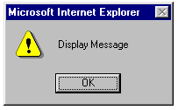

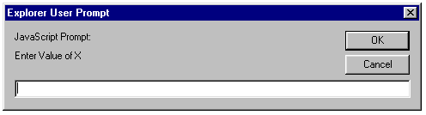
5.3: Window Object Window Object Methods
alert(message)
window.alert(“Display Message”)
confirm(message)
window.confirm(“Exit Application ?”)
prompt(message,[defaultReply])
var input= window.prompt(“Enter value of X”)

Slide 11
5.3: Window Object Window Object Methods
open(“URL”, “windowName” [, “windowFeatures”])
newwin=window.open(“new/URL”,”NewWindow”, “toolbar,status,resizable”)
close()
moveBy(deltaX,deltaY), moveTo(x,y)
scrollBy(deltaX,deltaY), scrollTo(x,y)

Slide 12
5.3: Window Object Window Object Methods
setTimeOut, clearTimeOut
y=setTimeOut('scroll()','100')
clearTimeOut(y)
setInterval, clearInterval
y=setInterval('scroll()','100')
clearInterval(y)

Slide 13
5.3: Window Object Window Object Event Handlers
Event Handler for the Window Object
onBlur
onFocus
onDragDrop
onLoad
onMove
onResize
onUnload
Notes:
Event Handlers
Table 6.3 Window Object Event Handlers

Slide 14
5.4: Frame Object Frame Object
Properties, methods and event handlers are same as the window object
Behaves exactly like a window object, except that it is created as part of a frameset by another document
The Event Handlers for a Frame are similar to window object event handlers
Notes:
About This Object
The properties, methods and event handlers of the frame object are same as window object. A frame object behaves exactly like a window object, except that it has been created as part of a frameset by another document. A frame object always has a top and a parent property different from its self property. If you load a document that is normally viewed in a frame into a single browser window, its window is no longer a frame.

Slide 15
5.5: Navigator Object Navigator Object
Netscape originally defined the navigator object for the Navigator 2 browser
Microsoft Internet Explorer also supports the object in its object model
The properties of the navigator object deal with the browser program the user runs to view documents
Notes:
Navigator Object
Netscape originally defined the navigator object for the Navigator 2 browser. Microsoft Internet Explorer also supports the object in its object model. Properties of the navigator object deal with the browser program the user runs to view documents. Properties include those for extracting the version of the browser and the platform of the client running the browser.

Slide 16
5.5: Navigator Object Navigator Object
Properties
appName | appCodeName
appVersion | userAgent
mimeTypes[ ] | Platform
plugins[ ] | cookieEnabled

Slide 17
Demo
Window_object.html
setTimeOut_method.html
Window_ex.html
setInterval_method.html

Slide 18

Lab
Lab Exercise 6 :
Working with Document Object Model (DOM)

Slide 19
5.6: Working with Location Object Rationale of Location Object
The Location object represents information about the URL of any currently open window or of a specific frame of an html document
A multiple-frame window displays the parent window’s URL in the Location field
Each frame also has a location associated with it, although no overt reference to the frame’s URL can be seen in the browser
Notes:
Working with Location Object:
To get URL information about a document located in another frame, the reference to the location object must include the window frame reference.
Most properties of a location object deal with network-oriented information.
This information includes various data about the physical location of the document on the network, including the host server, the protocol being used, and other components of the URL
The window.location object can be handy when a script needs to extract information about the URL, perhaps to obtain a base reference on which to build URLs for other documents to be fetched as the result of user action.
Setting the value of some location properties is the preferred way to control the document that gets loaded into a window or frame.
Location object properties and methods

Slide 20
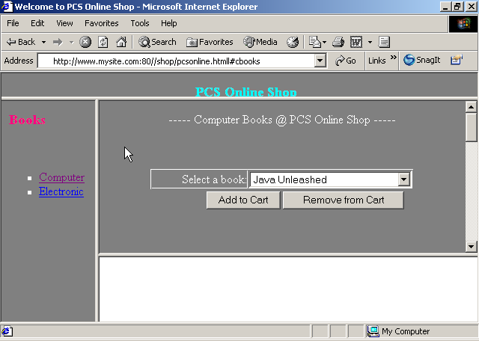
Rationale of Location Object
location.href
Notes:
Working with Location Object:
Given a complete URL for a typical WWW page, the window.location object assigns property names to various segments of the URL as shown in the above slide.

Slide 21
Location Object Properties
Let us see some of the Location Object Properties:
Property | Value
protocol | http:
hostname | www.mysite.com
port | 80
host | www.mysite.com:80
pathname | /shop/pcsonline.html
hash | #cbook
href | http://www.mysite.com:80/shop/pcsonline.html#cbooks
Notes:
Working with Location Object:
Let us discuss some of the location object properties.

Slide 22
Location Object Methods
Let us see some Location Object Methods:
assign(“URL”)
reload(uncGet)
replace(“URL”)
Notes:
Working with Location Object:
Location Object Methods:
Let us discuss some Location Object Methods:

Slide 23
5.7 : Working with History Object Rationale of History Object
The History object contains an array of previously visited URLs by the visitor
Notes:
Working with History Object:
As a user surfs the Web, the browser maintains a list of URLs for the most recent stops. This list is represented in JavaScript by the history object.

Slide 24
History Object Properties
Properties | Methods | Event Handlers
current | back() | None
length | forward()
next | go()
previous

Slide 25
Demo on Working with History Object
Demo with history_location.html
Notes:
Some additional egs:-
History_back.html
History_forward.html
History_go.html
History_Property.html
Location_Assign_method.html
Location_property.html
Location_reload_method.html
Location_replace_method.html

Slide 26
Lab
Lab Exercise 7 :
Working with Location and History Object.

Slide 27

Summary
Document Object Model is a interface that allows programs and scripts to dynamically access and update content, structure and style of documents
Window object is the topmost object in the entire scheme. It has properties, methods and event handles
Frame object is a browser object of JavaScript used for accessing HTML frames
Properties and methods of the frame object are similar to that of Window object in JavaScript
The history property has an array of history items having details of the URL’s visited from within that window
History object is a JavaScript object and not an HTML DOM object
The Location object contains information about the current URL

Slide 28

Review Questions
Question 1: Closed property returns ______ if the window object is closed either by a script or by the user.
Option 1: 1
Option 2: True
Option 3: 0
Question 2: An alert dialog box is a modal window that presents a message for users with a single OK button to dismiss it.
True / False
Question 3: Window’s ___________ event fires whenever a user drops a file or other URL-filled object onto the window.
Notes:
Answers
Option 2
True
Drag drop

Slide 29
Review Questions (Contd..)
Question 4: The __________ and appCodeName properties are simply the official name and the internal code name for the browser application.
Option 1: Appname
Option 2: appName
Option 3: applname
Question 5: The ___ property supplies a string of the entire URL of the specified window object.
Option 1: location.href
Option 2: hostname
Option 3: hash
Question 6: The ___ property describes both the hostname and port of a URL.
Notes:
Answers
4. Option 2
5. Option 1
6. host

